Slide 1
The 2024 vision board for your professional services business
Welcome to the 2024 Vision Board for Professional Services Teams. This is a free template, designed to inspire and guide you towards achieving your goals and aspirations. Follow these steps to make the most out of this vision board:
Reflect: Take some time to reflect on your past year's achievements, challenges, and lessons learned. Use these insights to draw up your 2024 vision.
Set goals: Identify and set SMART objectives and milestones you want to achieve in 2024.
Visualize: Utilize the template to visually represent your goals and aspirations. To help you get started, we’ve added short goals and images that resonate with our vision for success. Feel free to download the template and customize it as per your needs.
Share and collaborate: Collaborate with team members to contribute to the vision board and ensure alignment.
Review regularly: Regularly revisit the vision board to track progress, celebrate achievements, and adjust goals as needed. Use it as a dynamic tool to guide and inspire your team throughout the year.
Take action: Translate your vision into action by developing actionable plans and initiatives to work towards your goals.
Here’s to making your 2024 vision a reality.

Slide 2
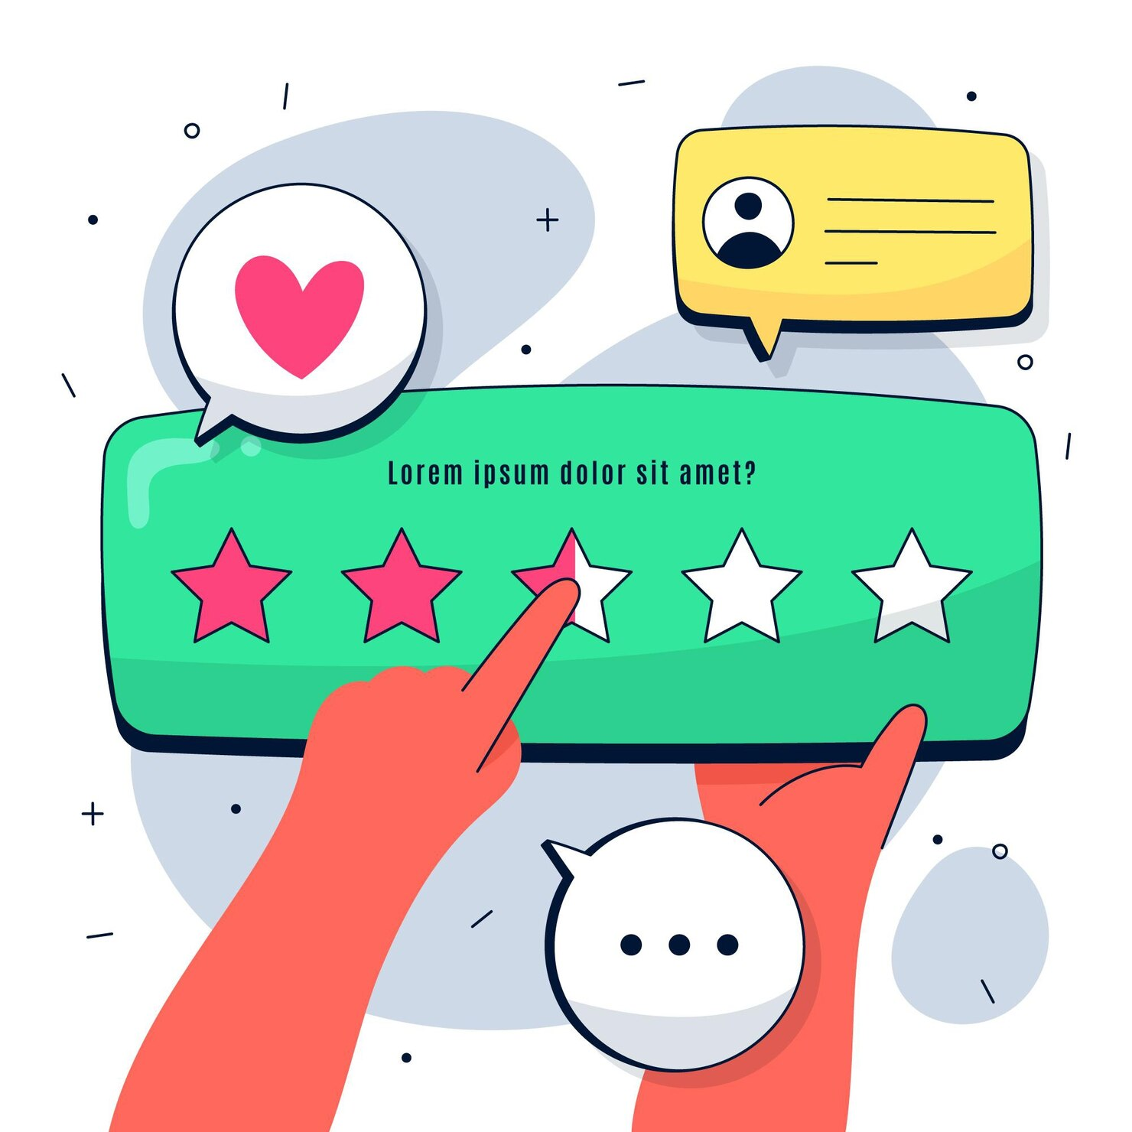
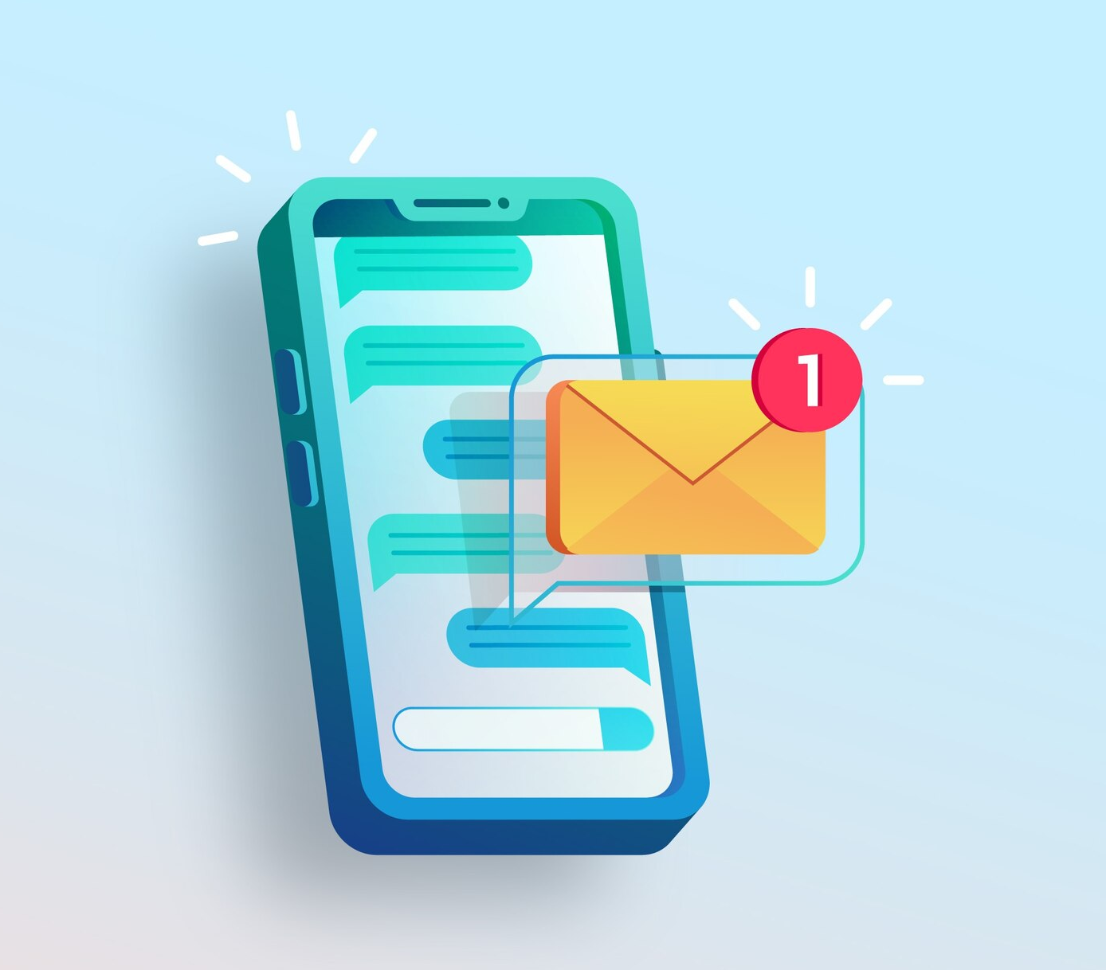
Build a solid project governance framework
Deliver exceptional UX for your services delivery
Establish client accountability
Contingency plan
Setup steering committee to unblock
Avg customer rating: 4.9
Project health dashboard
Set expectations with customers during kickoff
Reduce time to value for customers by 50%
Set up an escalation matrix
Automate project update notification to customers
Personalize project plans and templates unique to very customer
Change request management plan
Automate reminders about approvals
Automate tracking of milestones

